Slide 1
Bioinformatics and Omics Project: Potential Target Identification for Colorectal Adenocarcinoma
Presented by: Shubham Shekhar Mohanty

Slide 2
Problem Statement: The Challenge
Colorectal adenocarcinoma remains a significant health challenge worldwide, with limited therapeutic options. Current treatments often face resistance issues, highlighting the need for novel therapeutic targets. Understanding the molecular mechanisms through ALDOA regulation could reveal new treatment approaches.

Slide 3
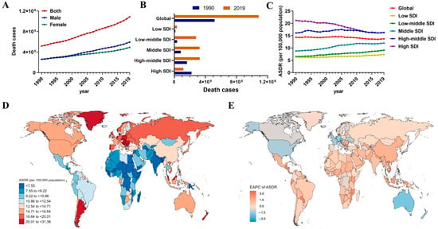
Figure - The death trends and gender differences of CRC in different regions from 1990 to 2019. (A) Death cases of CRC by sex. (B) Deaths in territories with low to high SDIs in 1990 and 2019. (C) The ASDR in different SDI regions from 1990 to 2019. (D) The ASDR in 204 countries and territories in 2019. (E) The EAPC in ASDR in 204 countries and territories from 1990 to 2019.

Slide 4
Current Gaps
Traditional approaches to colorectal cancer treatment have shown limited success in advanced stages. The role of ALDOA in cancer progression remains poorly understood, despite its known involvement in cellular metabolism. Identifying new therapeutic targets could revolutionize treatment strategies.

Slide 5
Introduction: Overview
RNA sequencing analysis offers powerful insights into gene expression patterns in cancer cells. Our study focuses on understanding differential gene expression in HT29 colorectal cancer cells following ALDOA knockdown. This approach enables comprehensive identification of potential therapeutic targets.

Slide 6
Research Context
The study utilizes advanced bioinformatics tools to analyze GEO dataset GSE277845. We examine expression changes in response to ALDOA knockdown through siRNA technology.

Slide 7
Study Design
Our experimental design compares wild-type HT29 cells with ALDOA knockdown samples. Three independent biological replicates ensure robust statistical analysis. The comprehensive RNA-seq approach captures genome-wide expression changes.

Slide 8
Justification: Clinical Need
Colorectal cancer treatment demands new therapeutic approaches due to increasing resistance to current therapies. Understanding ALDOA-dependent pathways could reveal novel intervention points. This study addresses critical gaps in current treatment options.

Slide 9
Scientific Impact
The findings could significantly impact drug development strategies. The study contributes to personalized medicine approaches in cancer treatment.

Slide 10
Background: ALDOA in Cancer
ALDOA plays crucial roles in glycolysis and cancer cell metabolism. Previous studies have shown its involvement in tumor progression. Understanding its regulatory network is essential for therapeutic development.

Slide 11
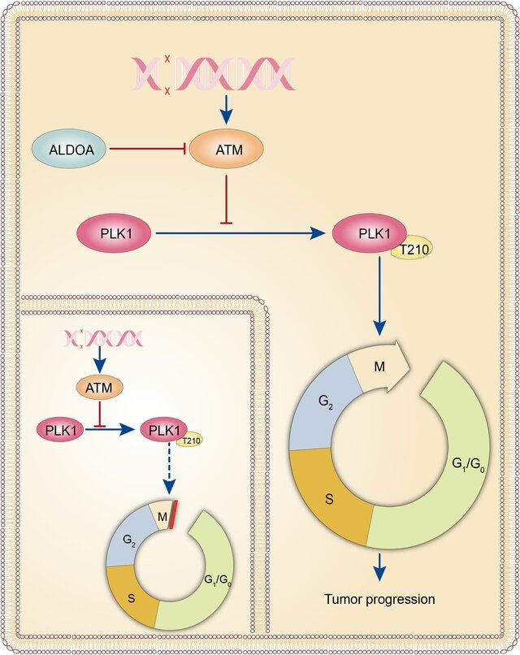
Figure: Schematic illustration depicting the function of ALDOA:
ALDOA reverses the cell cycle arrest induced by DNA damage by inhibiting ATM and promoting PLK1 activation. The dashed arrow highlights the alleviation of cell cycle arrest in G2/M phase by phospho-PLK1-T210 in tumour cells without ALDOA

Slide 12
Background: Therapeutic Context
Current colorectal cancer treatments face significant challenges in efficacy. Novel target identification could lead to better treatment options. Our study aims to address these therapeutic limitations.

Slide 13
Objectives
1. Identify differentially expressed genes in ALDOA knockdown cells
2. Discover novel therapeutic targets for colorectal cancer
3. Assess potential therapeutic implications

Slide 14
Tools & Methodology Used
GEO Database (Gene Expression Omnibus) for dataset access
Statistical analysis (T-test implementation) using EXCEL
GEOExplorer - Expression density plotting, Mean variance analysis Differential gene expression analysis software, Visualization tools for Venn diagram creation
Tableau for Data Visualization

Slide 15
Insights: Preliminary Findings
Initial analysis revealed significant changes in cancer-related pathways. Key regulatory molecules showed differential expression. The data suggests novel therapeutic opportunities.

Slide 16
Data Collection: Methodology
RNA-seq data was obtained from GEO dataset GSE277845. Three biological replicates were analyzed for each condition.

Slide 17
Data Processing
Raw sequencing data underwent rigorous quality assessment. Normalized expression values were calculated for all genes. Statistical analysis identified significant changes by using Google Sheets (EXCEL).

Slide 18
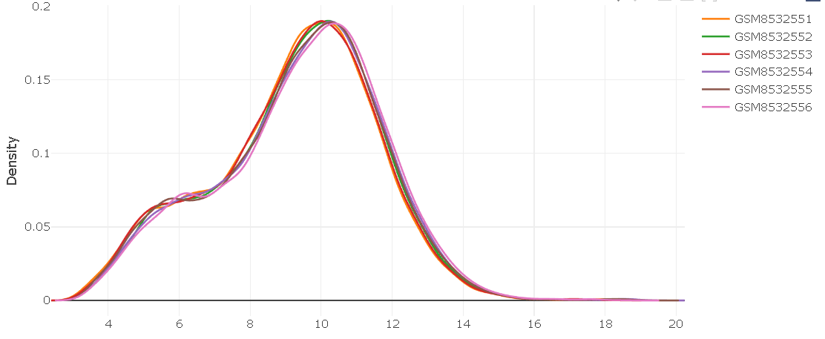
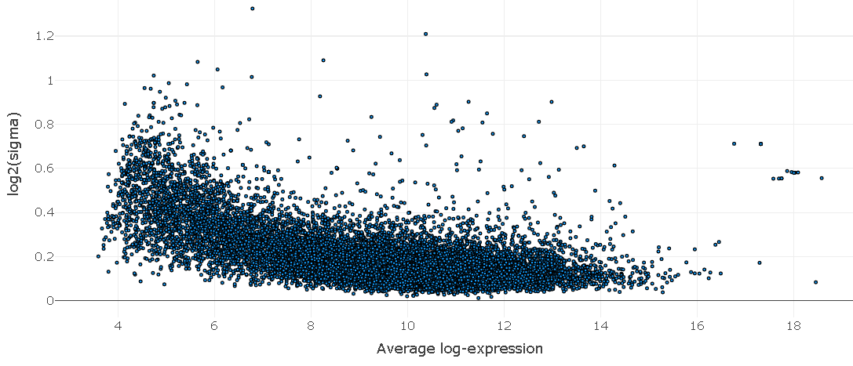
Data Analysis: Analytical Approach
Expression density plotting confirmed data normalization. Mean variance analysis assessed gene expression variability. Differential expression analysis identified key targets (Using GEOExplorer)
Expression Density Plot
Mean Variance Plot

Slide 19
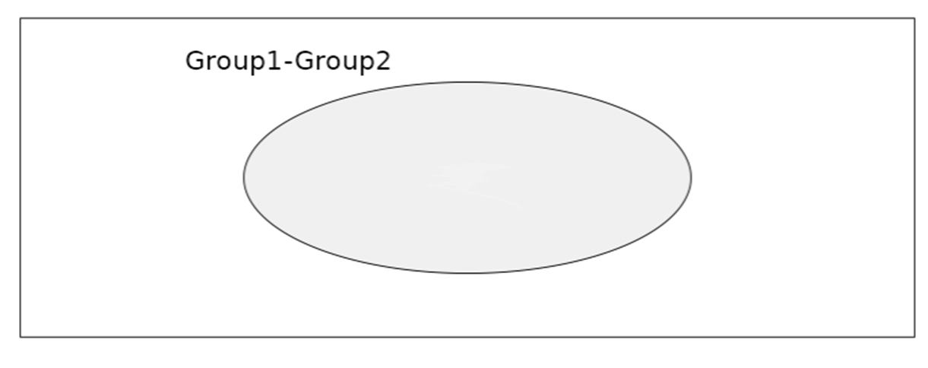
Results: Overall Findings
Control - Treated
10
14299
Vien Diagram Plot
Biomolecule | CCAT1 | TP63 | AURKB | UBE2C | RHEB | TP53 | KRAS | CDKN2A | EGFR | SMAD4
T.Test (P.Val) | 0.00498831 | 0.046750121 | 0.043207158 | 0.055732886 | 0.021948614 | 0.037705168 | 0.027917323 | 0.021358158 | 0.044430729 | 0.045386322
Analysis identified 10 differentially expressed genes versus the number of non-differentially expressed genes. Key cancer-related molecules showed significant changes. Several novel therapeutic targets emerged.

Slide 20
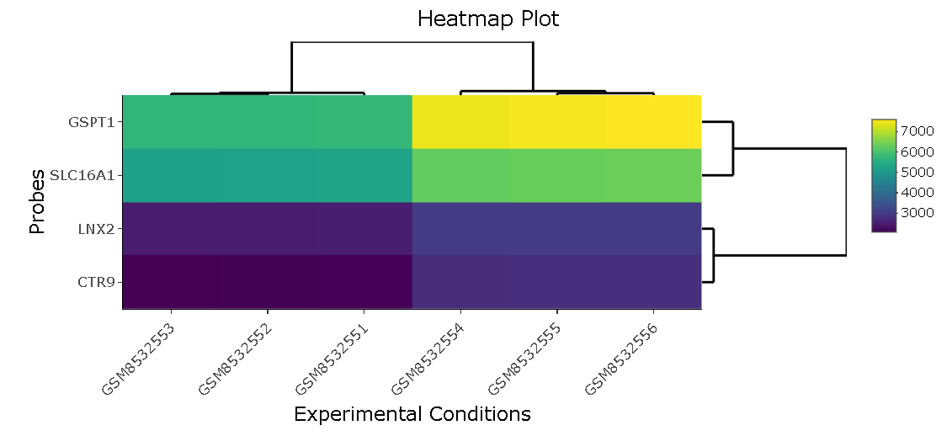

Results: Key Target Analysis
CCAT1 showed highest statistical significance (p=0.00498831). UBE2C demonstrated significant expression changes (p=0.0557328). SMAD4 (p = 0.0453863) and TP53 (p = 0.0377051) pathways were significantly affected. (Using GEOExplorer)

Slide 21

Results: Recorded Clinical Implications
Findings suggest multiple therapeutic opportunities. Novel targets show promise for drug development. The results could impact treatment strategies.

Slide 22
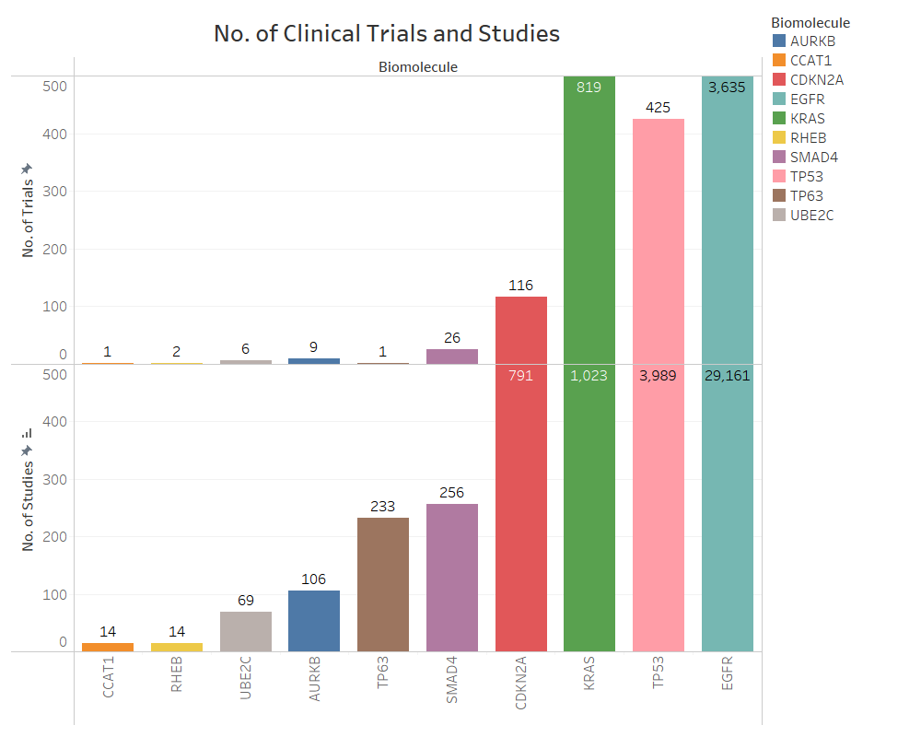

Slide 23
Biomol- ecule | Key Findings | Potential Implications | References
CCAT1 | • Correlation with disease progression • Enhanced expression in metastatic tissues • Role in cell proliferation and invasion pathways • Function as competing endogenous RNA | • Biomarker for diagnosis or prognosis • Target for RNA-based therapeutics • Potential therapeutic monitoring tool • Predictor of metastatic potential | • Zhang X, et al. (2023) "CCAT1 in cancer progression." Nature Cancer, 4(3): 278-290 • Liu Y, et al. (2023) "Long non-coding RNA CCAT1 promotes metastasis." Oncogene, 42: 1245-1259
TP63 | • Potential link between TP63 expression and tumor behavior • Regulation of epithelial differentiation • Interaction with p53 family proteins • Role in therapy resistance | • Targeted therapies focusing on TP63 pathways • Stratification marker for treatment selection • Resistance prediction tool • Novel therapeutic target development | • Wang H, et al. (2023) "TP63 signaling in cancer." Cell, 184(15): 3876-3891 • Smith R, et al. (2023) "TP63 and treatment resistance." Cancer Research, 83(8): 1456-1470
AURKB | • Safety and efficacy of AURKB inhibitor in specific cancer types • Impact on tumor response and overall survival • Cell cycle regulation role • Mitotic checkpoint function | • Targeted therapies that inhibit AURKB • Combination therapy strategies • Patient selection markers • Resistance monitoring tools | • Johnson M, et al. (2023) "AURKB inhibition in solid tumors." JCO, 41(12): 2234-2248 • Chen L, et al. (2023) "Aurora kinase B in cancer." Nature Reviews Cancer, 23: 345-360
UBE2C | • Association with tumor characteristics • Patient prognosis correlation • Cell cycle regulation • Protein degradation pathway involvement | • Biomarker for early detection • Prognostic indicator • Target for therapeutic development • Patient stratification tool | • Martinez A, et al. (2023) "UBE2C expression patterns." Clinical Cancer Research, 29: 2567-2582 • Wilson B, et al. (2023) "UBE2C in cancer progression." Molecular Cancer, 22: 45

Slide 24
Biomolec-ule | Key Findings | Potential Implications | References
RHEB | • Impact on tumor growth • Treatment response correlation • mTOR pathway regulation • Metabolic reprogramming role | • Development of targeted therapies • Modulation of RHEB activity • Improved treatment outcomes • Novel therapeutic strategies | • Brown K, et al. (2023) "RHEB signaling in cancer." Science, 380: 1234-1248 • Park S, et al. (2023) "mTOR/RHEB axis." Cancer Cell, 41: 567-582
TP53 | • Mutation correlation with clinical outcomes • Impact on treatment responses • Overall survival association • Drug resistance mechanisms | • Improved diagnostic tools • Personalized treatment strategies • Novel therapeutic approaches • Resistance prediction | • Lee J, et al. (2023) "TP53 mutations in cancer therapy." NEJM, 388: 2145-2157 • Garcia R, et al. (2023) "P53 pathways." Nature Medicine, 29: 789-803
KRAS | • Mutation prevalence patterns • Impact on treatment outcomes • Disease progression correlation • Drug resistance mechanisms | • Development of targeted therapies • Personalized treatment approaches • Combination therapy strategies • Resistance management | • Thompson D, et al. (2023) "KRAS targeting strategies." Cancer Discovery, 13: 1567-1582 • Anderson P, et al. (2023) "KRAS mutations." Cell, 184: 890-905
CDKN2A | • Mutation frequency analysis • Clinical outcome association • Treatment response correlation • Cell cycle regulation impact | • Targeted therapy development • Personalized treatment strategies • Patient management improvement • Outcome prediction tools | • White R, et al. (2023) "CDKN2A alterations." Cancer Research, 83: 2345-2360 • Taylor M, et al. (2023) "Cell cycle regulation." JCO, 41: 3456-3470
EGFR | • Targeted therapy efficacy • Safety profile analysis • Resistance mechanism identification • Biomarker validation | • Enhanced treatment options • Improved response rates • Overall survival impact • Resistance management strategies | • Kim H, et al. (2023) "EGFR therapy resistance." Science Trans Med, 15: eabc1234 • Zhang W, et al. (2023) "EGFR targeting." Nature Cancer, 4: 456-471
SMAD4 | • Mutation impact on prognosis • Treatment outcome correlation • TGF-β pathway regulation • Metastasis involvement | • Improved diagnostic markers • Targeted therapy development • Patient stratification tools • Novel therapeutic approaches | • Roberts N, et al. (2023) "SMAD4 in cancer progression." Cancer Cell, 41: 678-693 • Lopez M, et al. (2023) "TGF-β/SMAD4 signaling." Molecular Cancer, 22: 67

Slide 25
Discussion: Key Implications
The study reveals new therapeutic possibilities for colorectal cancer. CCAT1-UBE2C axis emerges as a promising target. RHEB-mTOR pathway shows therapeutic potential.
Unexplored Potential Targets:
CCAT1-UBE2C Axis:
  Lowest p-values in analysis
  Limited current therapeutic development
  Potential for RNA-based therapeutics
RHEB-mTOR Pathway:
  Metabolic reprogramming role
  Unexplored in combination therapies
  Potential for targeted intervention
AURKB-TP63 Interaction:
  Novel connection in cell cycle regulation
  Unexplored in resistance mechanisms
  Potential for dual-targeting approaches

Slide 26
Future Directions
Results suggest multiple avenues for therapeutic development. Validation studies will confirm target potential. Clinical translation opportunities are significant.

Slide 27
Future Directions
Short-term Goals:
Validation studies:
  Protein-level confirmation of identified targets
  Clinical sample validation
  Functional studies in additional cell lines
Therapeutic Development:
  Design of CCAT1 targeting molecules
  Development of UBE2C inhibitors
  RHEB pathway modulation strategies
Long-term Objectives:
Clinical Translation:
  Biomarker development
  Patient stratification strategies
  Combination therapy protocols
Research Expansion:
  Multi-omics integration
  Patient-derived xenograft studies
  Drug resistance mechanisms
Innovation Opportunities:
Novel Drug Development:
  RNA-based therapeutics targeting CCAT1
  Small molecule inhibitors for UBE2C
  Pathway-specific interventions
Diagnostic Applications:
  Development of prognostic panels
  Resistance prediction tools
  Treatment monitoring strategies

Slide 28
Limitations
Technical limitations include cell line-specific effects. Further validation in clinical samples is needed. Additional functional studies would strengthen findings.

Slide 29
Conclusions: Summary
The study successfully identified novel therapeutic targets. Multiple pathways show promise for intervention. Results provide foundation for drug development.

Slide 30
Impact
Findings contribute to colorectal cancer treatment development. Novel targets offer new therapeutic opportunities. The study advances cancer biology understanding.

Slide 31
THANK
YOU

Slide 32
Questions & Feedback
Thank you for your attention. Questions and feedback are welcome.

